Slide 1
IPL Match Winner Prediction Using Machine Learning
NAME: Indharajith G

Slide 2
INTRODUCTION
Problem Overview:
The aim of this project is to apply machine learning methods to predict the outcomes of IPL cricket matches.
The focus is on creating a reliable predictive model that can estimate the winning team based on historical match data.
Dataset Summary:
The dataset contains essential information such as the season, participating teams, toss decisions, match results, and venues. Data analysis and processing are carried out using Python tools like Pandas, NumPy, Matplotlib, and Seaborn. It includes both categorical and numerical attributes, making it ideal for supervised machine learning tasks.
Project Goals:
Perform data preprocessing and exploratory analysis on the IPL dataset.
Develop predictive models using algorithms such as Logistic Regression, SVM, KNN, Decision Tree, Random Forest, and XGBoost.
Assess model performance through evaluation metrics like accuracy, precision, recall, and F1-score.
Optimize hyperparameters to identify and finalize the most accurate prediction model

Slide 3
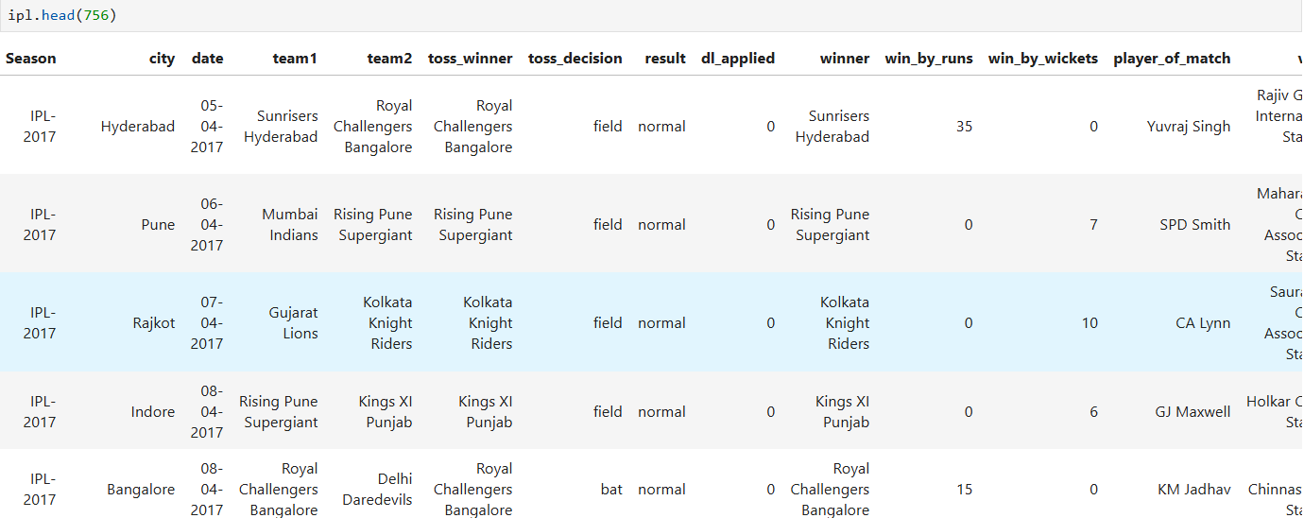
DATA UNDERSTANDING
The dataset comprises past IPL match information and includes several important attributes:
Season: Indicates the year of the IPL tournament.
Team1 & Team2: Represent the two teams competing in a given match.
Toss Winner: Specifies which team won the toss.
Toss Decision: Describes whether the toss-winning team opted to bat or field first.
Venue: Denotes the stadium where the match was held.
Winner: Identifies the team that emerged victorious.
Player of the Match: Highlights the standout performer of the game.
Win by Runs / Wickets: Shows the margin by which the winning team secured victory.
Date: Refers to the day on which the match was played.

Slide 4
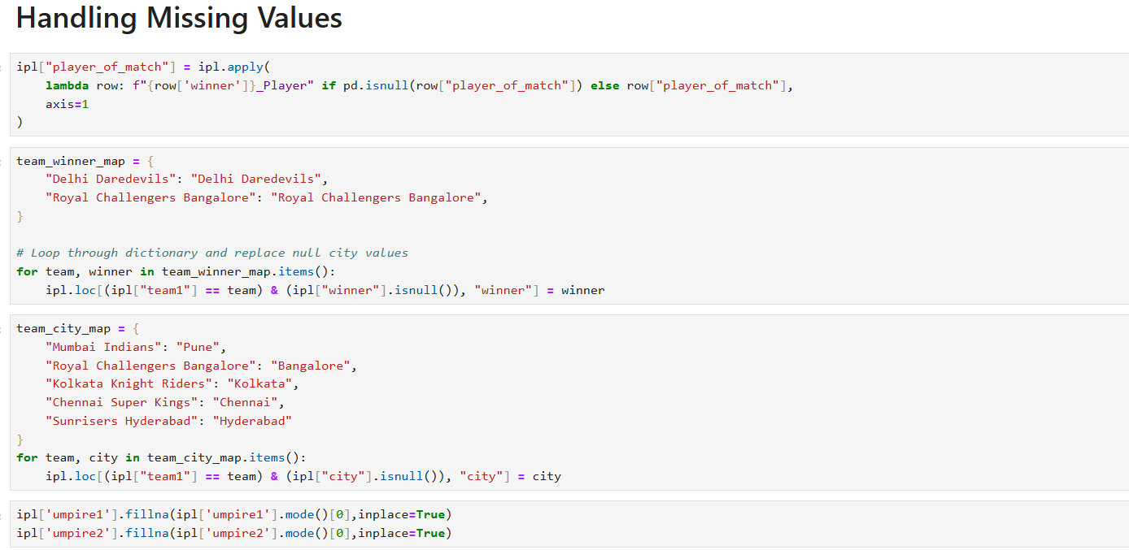
Data Cleaning
Steps Performed:
Converted the date column into a consistent format (YYYY-MM-DD).
Standardized team names to maintain uniformity across the dataset.
Removed duplicate records, if present, to ensure data accuracy.
Handling Missing Data:
Replaced missing values in the ‘Player of the Match’ column with the respective winning team’s player.
Verified and addressed null values in key fields such as teams, season, venue, and winner to maintain dataset completeness.
Key Insights:
Rather than deleting rows with missing entries, meaningful replacements were implemented.
Domain understanding (such as team–city relationships and winner associations) was utilized to fill in missing information.
This strategy enhances data integrity and model accuracy without sacrificing valuable records.
Ensures that categorical and text-based features are fully prepared for encoding and machine learning tasks.

Slide 5
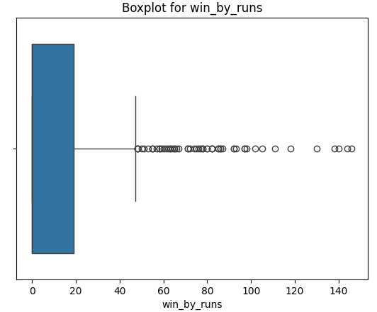
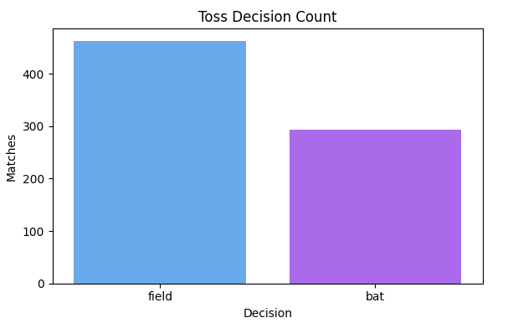
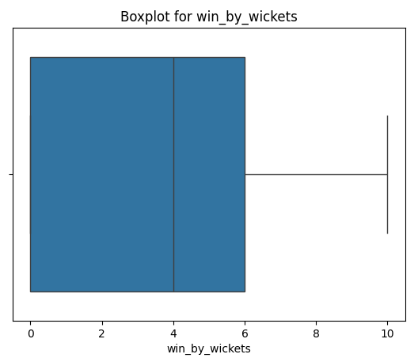
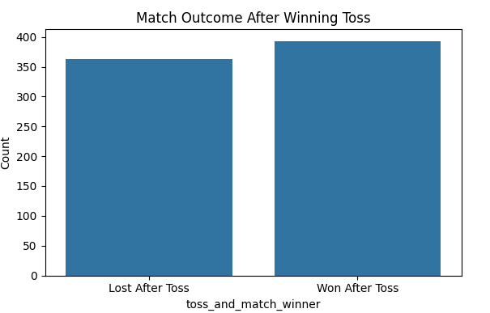
Exploratory Data Analysis (EDA)
Most successful teams: Mumbai Indians, Chennai Super Kings, and Kolkata Knight Riders stand out as the leading sides with the greatest number of wins.
Toss decisions: Captains more often choose to bowl first (about 61.2%) than to start batting (around 38.8%), reflecting a preference for chasing targets.
Wins by wickets: Many victories come with large wicket margins—often finishing with all wickets in hand or by about 6–8 wickets—showing decisive performances.
Wins by runs: Run-defenses are typically tight, with the bulk of such matches decided by fewer than 20 runs

Slide 6
Modeling Process
Input Data
Models
Hyperparameter tuning
Evaluation metrics
Logistic regression
SVM
KNN
Decision trees
Random forest
Xgboost
Accuracy
Confusion Matrix
Precision
Recall
F1 Score.
Grid Search
Random Search

Slide 7
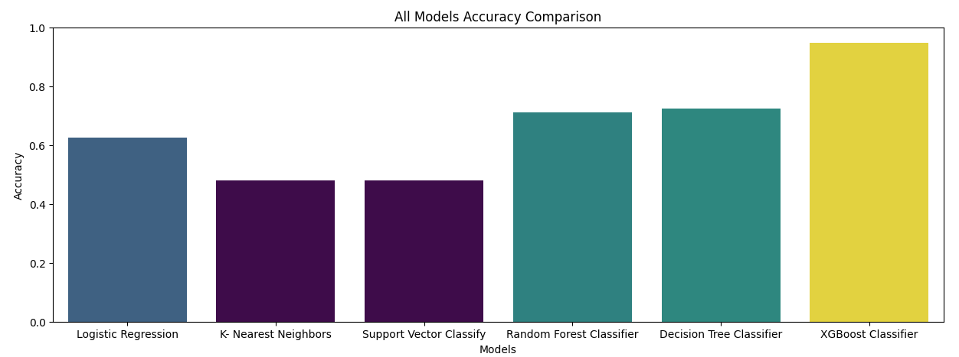

Model Comparison
Performance Comparison of Each Model
Best Model – XGBoost (XG):
Delivers the highest accuracy (~0.97–0.98) among all tested algorithms.
Excels at managing both linear and non-linear patterns, making it ideal for structured/tabular data.
Demonstrates consistent and robust predictive capability.
Strong Performers – Random Forest & Decision Tree:
Achieve accuracies of around 0.87–0.89, indicating solid results but slightly below XGBoost.
Random Forest outperforms a single Decision Tree by combining multiple trees (ensemble averaging), which helps reduce overfitting and improve stability.
Moderate Models – KNN & SVC:
K-Nearest Neighbors (KNN) reaches about 0.47 accuracy, performing moderately better than Logistic Regression.
Support Vector Classifier (SVC) records roughly 0.41 accuracy, showing limited adaptability to this dataset’s complexity.
Lowest Performer – Logistic Regression (LR):
Records the lowest accuracy (~0.29).
Its linear nature makes it less suitable for the highly non-linear and complex characteristics of IPL match data.
XG Boost

Slide 8
Conclusion
Model Enhancement:
Optimize model parameters using techniques such as Grid Search, Randomized Search, or Bayesian Optimization.
Apply advanced feature engineering methods (handling missing data, scaling, and encoding features effectively).
Utilize cross-validation strategies to minimize overfitting and ensure reliable model assessment.
Address class imbalance using SMOTE, undersampling, or oversampling techniques when necessary.
Investigate ensemble learning methods like stacking, bagging, and boosting variations to improve accuracy.
Next Steps:
Gather more diverse and high-quality data to improve model training and generalization.
Integrate the best-performing model (XGBoost) into a real-time application or production system.
Continuously track and evaluate model performance to identify concept drift or degradation over time.
Incorporate model interpretability tools (e.g., SHAP, LIME) for better explainability and trust.
Explore deep learning approaches if the dataset expands significantly to capture more complex patterns.

Slide 9
THANK YOU

